Slide 1
Lecture 3
Eclipse Environment with Making Your First App Example?

Slide 2
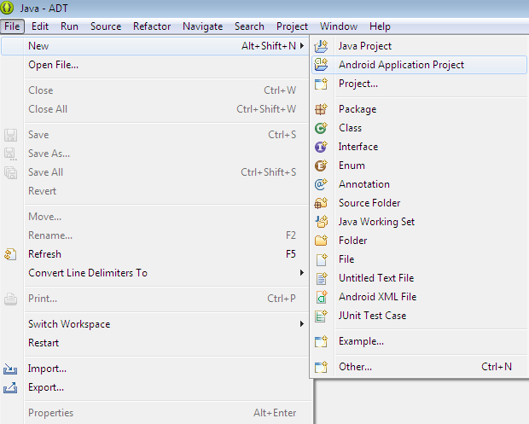
Step 1 for Creating Android Project

Slide 3
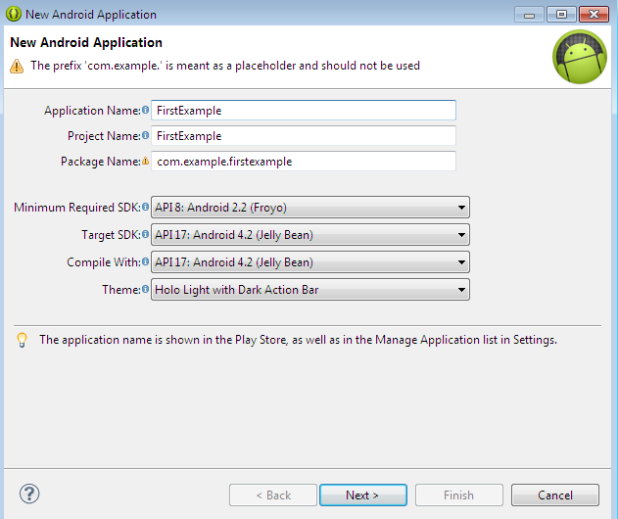
Step 2 for Creating Android Project

Slide 4
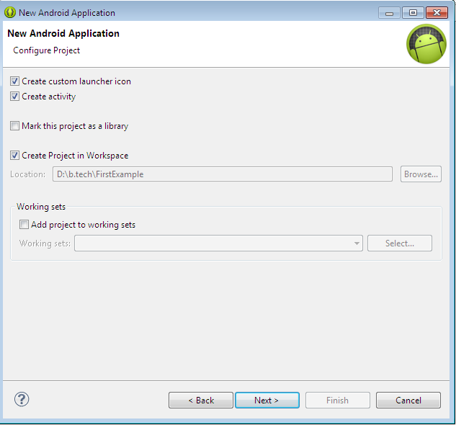
Step 3 for Creating Android Project

Slide 5
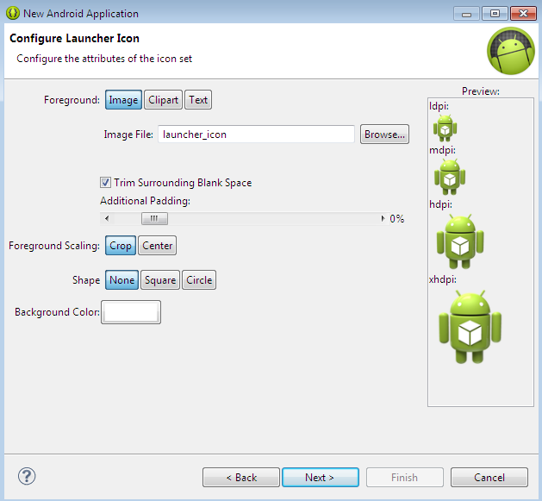
Step 4 for Creating Android Project

Slide 6
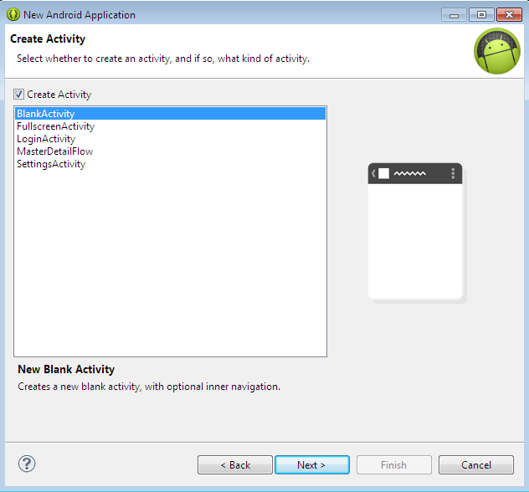
Step 5 for Creating Android Project

Slide 7
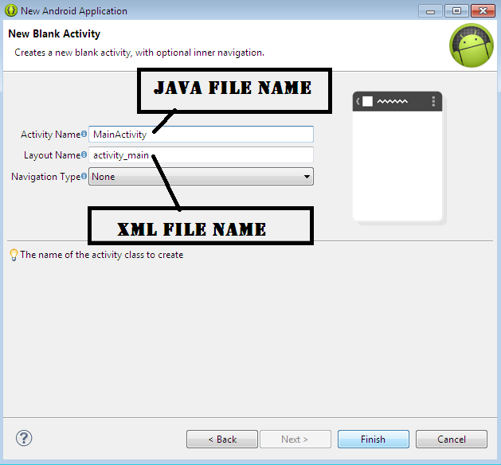
Step 6 for Creating Android Project

Slide 8
Run Your Project
Right Click on Your Project Folder.
Run As -> Android Application
Internal Steps will be are :
1. New emulator found.
2. Waiting for HOME Screen.
3. HOME is up on device 'emulator-5554‘.
4. Uploading FirstExample.apk onto device 'emulator-5554‘.
5. Installing FirstExample.apk...
6. Success!
7. Starting activity com.example.firstexample.MainActivity on device emulator-5554.
8. Activity-Manager: Starting….
9. Now, You will see output of your project.

Slide 9
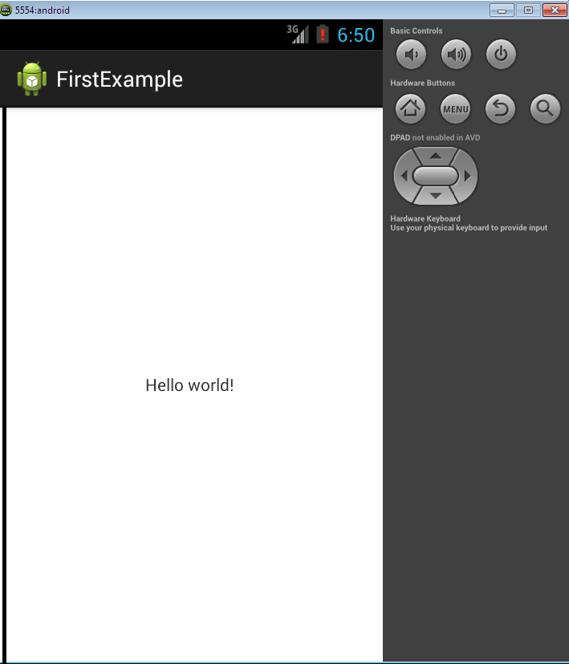
Output of Your Project

Slide 10
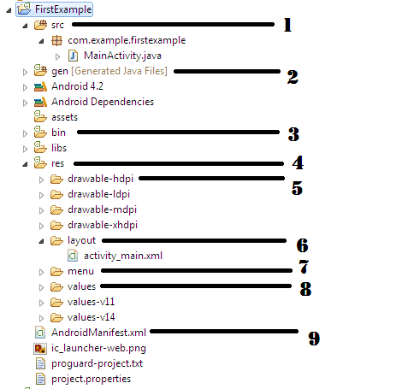
Anatomy of Android Application

Slide 11
Anatomy of Android Application
S.N. | Folder, File & Description
1 | Src This contains the .java source files for your project. By default, it includes an MainActivity.java source file having an activity class .
2 | Gen This contains the .R file, a compiler-generated file that references all the resources found in your project. You should not modify this file.
3 | Bin This folder contains the Android package files .apk built by the ADT during the build process and everything else needed to run an Android application.
4 | Res This folder will contain Drawable, Layout, Menu, Values folder.

Slide 12
Anatomy of Android Application
S.N. | Folder, File & Description
5 | res/drawable-hdpi This is a directory for drawable objects that are designed for high-density screens. Example: Images, files etc.
6 | res/layout This is a directory for files that define your app's user interface.
7 | res/menu This folder will contains all menus files of your app.
8 | res/values This is a directory for other various XML files that contain a collection of resources, such as strings and colors definitions.
9 | AndroidManifest.xml Whatever component you develop as a part of your application, you must declare all its components in a manifest.xml. This file works as an interface between Android OS and your application, so if you do not declare your component in this file, then it will not be considered by the OS. Components Like: All Java File Names, Permissions, App Name, App ICON, App Theme etc…

